Slide 1
IMPLEMENTATION AND MAINTENANCE OF THE WATER RECONCILIATION STRATEGY FOR RICHARDS BAY AND SURROUNDING TOWNS
Strategy Steering Committee Meeting
(StraSC) 3
Wednesday, 4 September 2019

Slide 2
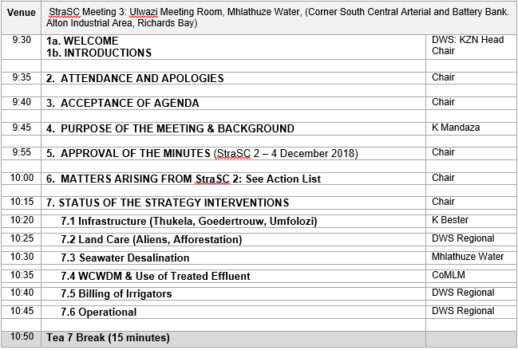
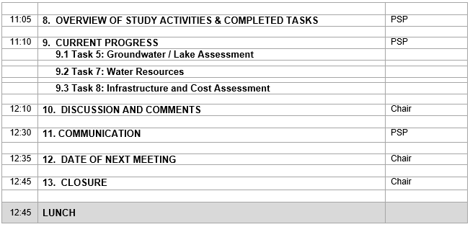
Agenda

Slide 3
IMPLEMENTATION AND MAINTENANCE OF THE WATER RECONCILIATION STRATEGY FOR RICHARDS BAY AND SURROUNDING TOWNS
Strategy Steering Committee Meeting
(StraSC) 3
Item 4: Purpose of the Meeting

Slide 4
ROLE OF THE STRATEGY STEERING COMMITTEE
As members of the StraSC your responsibility is to:
Drive processes assigned to your organization relating to Strategy Interventions
Provide feedback to Committee on progress of Actions
Disseminate information into the relevant departments / organisations
Incorporate strategies’ recommendations into development plans

Slide 5
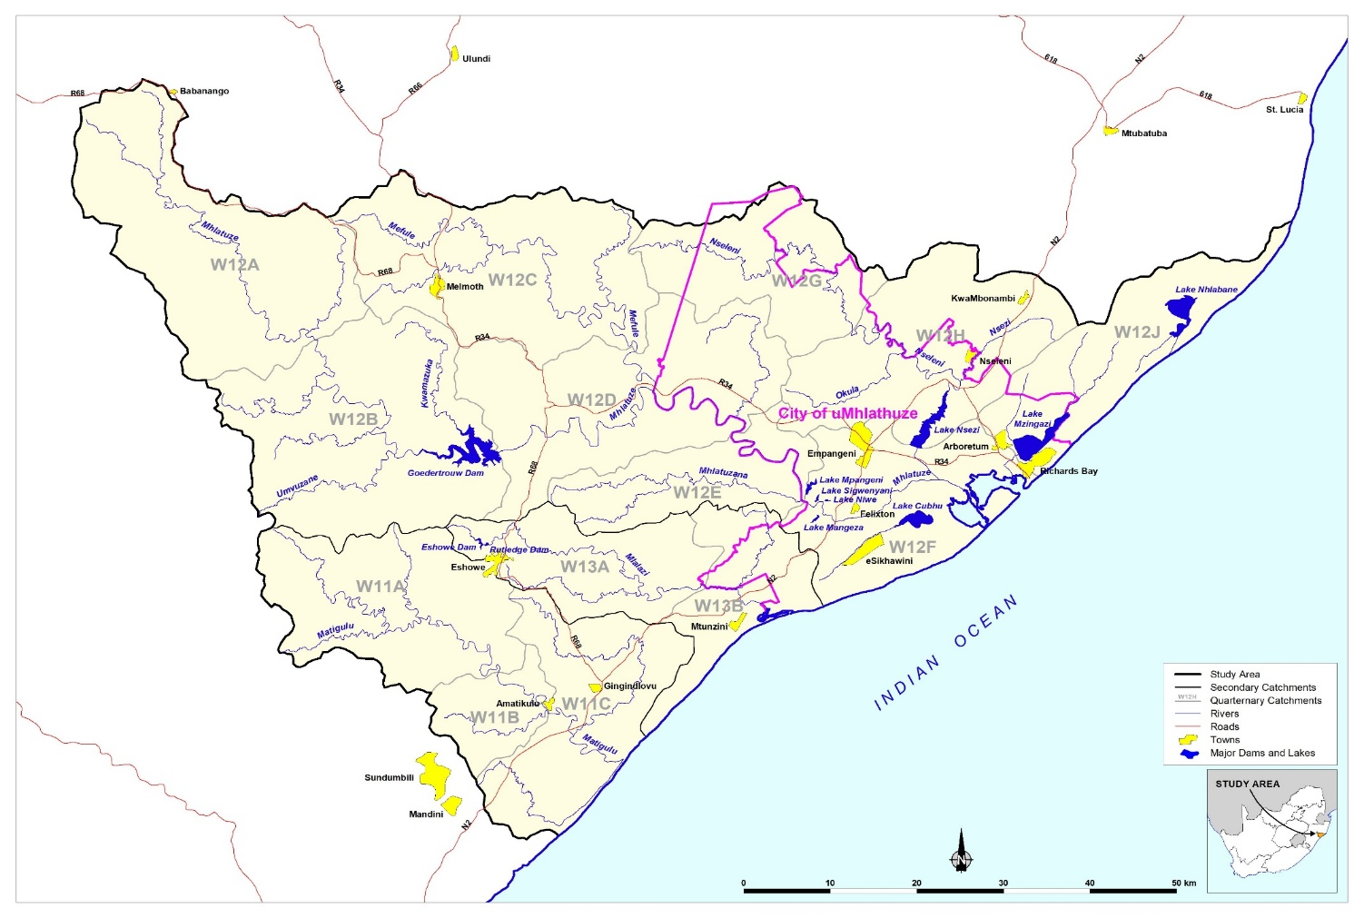
Background to this Assignment
Reconciliation Strategy for the Richards Bay area was developed (2015)
Recommends sequence of management and infrastructural interventions required to maintain acceptable assurances of supply to the users.

Slide 6
Outcomes of previous assignment
Options for reconciling increasing water requirements with the current supply in the Mhlathuze Catchment included:
Water Conservation and Demand Management (WC/WDM)
Removal of Invasive Alien Plants (IAPs) and unlawful afforestation
Infrastructure: Raising Goedertrouw, Transfers: Thukela & Umfolozi, Nseleni Dam
Improvement of System Operation
Seawater Desalination
Reuse of treated effluent
Improved billing of irrigators
Please visit: http://www6.dwa.gov.za/iwrp/projects.aspx for all project related information

Slide 7
Why Continuation of a Strategy? (This Study)
  Water balances need to be continuously monitored / investigated and the strategy regularly updated to remain technically relevant.
  Ensures that intervention planning can be implemented taking into account any changes that may impact on the projected water balance.
  Study Objective: In-depth review, systematically update and improve the water resource reconciliation strategy so that it remains relevant, technically sound, economically viable, socially acceptable and sustainable and thus enabling the implementation of the strategy by the relevant authorities.

Slide 8
Purpose of the Meeting
  Overview of study activities since StraSC Meeting 2 (4 Dec 2018)
  Feedback on Strategy interventions

Slide 9
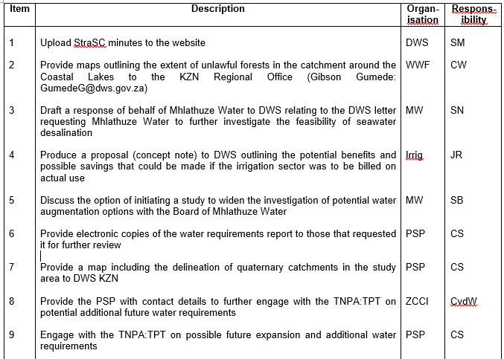

Matters Arising: Action list

Slide 10
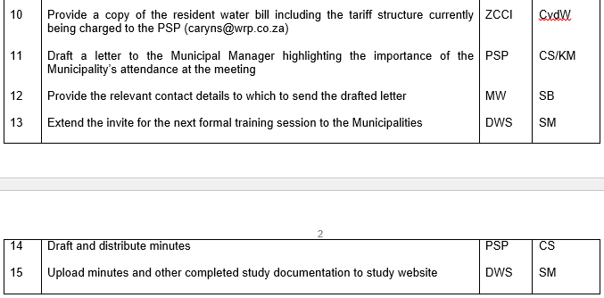
Matters Arising: Action list

Slide 11
IMPLEMENTATION AND MAINTENANCE OF THE WATER RECONCILIATION STRATEGY FOR RICHARDS BAY AND SURROUNDING TOWNS
Strategy Steering Committee Meeting
(StraSC) 3
Item 7: Status of Strategy (2015) Interventions

Slide 12
7.1 INFRASTRUCTURE
Action | Responsibility | Comment
Thukela Initiate a comparison pre-feasibility study Increased capacity of Thuk-Mhlat Transfer scheme (Middledrift) Coastal transfer pipe at Mandini | DWS: D: OA | To be reported on under item 9.3
Umfolozi Initiate a study including hydrology update, assessment of water requirements, system modelling etc. Initiate a comparison pre-feasibility study to compare Mfolozi transfer scheme with others | DWS: D: OA
Goedertrouw Raising Initiate a full feasibility study to evaluate Goedertrouw raising | DWS: D: OA

Slide 13
7.2 LANDCARE
Action | Responsibility | Timing
Actively support clearing programmes for alien invasive plants | All Stakeholders | Ongoing High
Investigate the reduction of illegal / commercial afforestation in immediate vicinity of coastal lakes | DWS | High

Slide 14
Afforestation Review
  Background:
    2015 Strategy Intervention: Investigate the reduction of illegal / commercial afforestation in immediate vicinity of coastal lakes
    2018 StraSC meeting feedback by DWS KZN: “Not aware of any illegal afforestation remaining in the Study area, asked that item be removed”
    Action C Webb to send details to G Gumede, sent map of afforestation from MWAAS (2009) and statement “Having spent some time in the catchment we have seen that the extent of informal forestry (red areas on the map) around the coastal lakes has increased since this report was published.
  Objective: To obtain all info on afforestation and provide perspective on legality status

Slide 15
History
  MWAAS: 2006-2009
    Info to be based on WARMS/Validation
    Appeared to be only commercial users in database
    Carried out aerial photograph assessment
  Validation Study (2005): 61 192ha planted
  Aerial photography:
    62 717 ha commercial plantations
    4994 ha informal timber
    Total: 67 711 ha

Slide 16
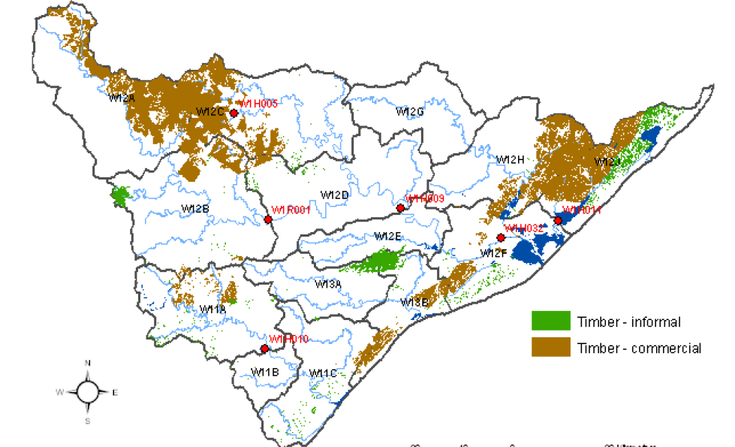
MWAAS Afforestation (aerial photographs)

Slide 17

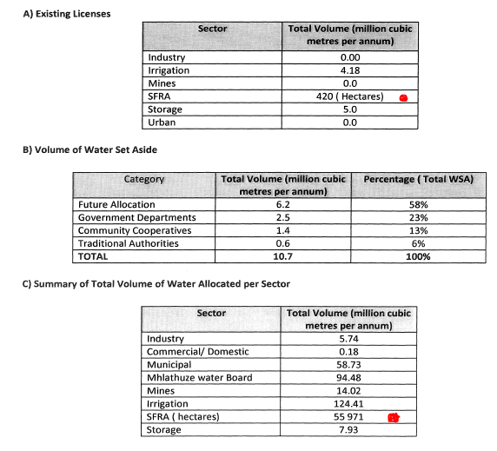
Gazetted:
55 971 + 420 = 56 391 ha

Slide 18
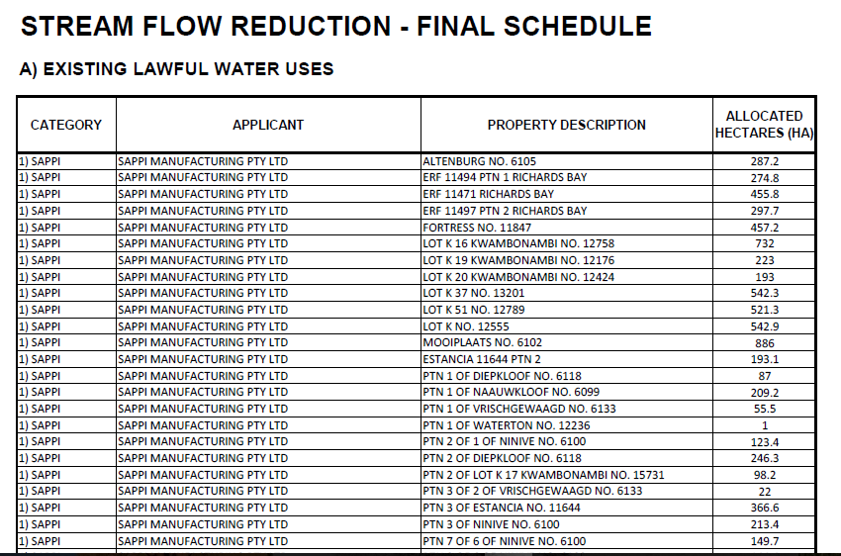
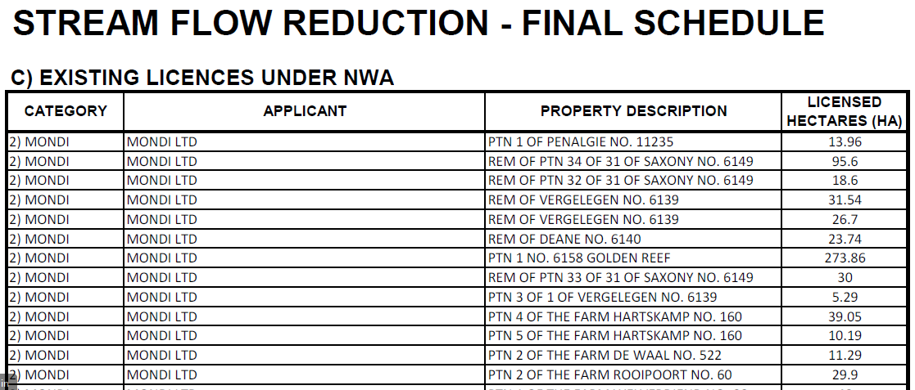
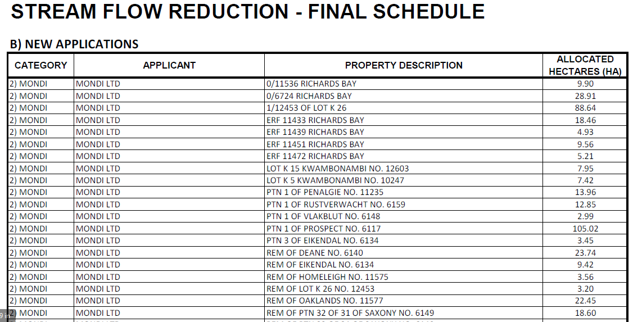
Final Allocation schedules
Total of 496 individual entries: 57 029 ha
Assume this is lawful

Slide 19
Question?
  The MWAAS aerial photograph assessment indicated 67 711ha
  BUT final allocation schedule said 57 029ha
  What happened to difference of 10 682ha if the Regional Office states there is no unlawful afforestation in the catchment ?
  Were there errors or was it removed?
  Spot checks carried out

Slide 20
Result
  Overlaid shape file polygons determined in MWAAS in Google Earth
  Differences clearly evident now (2019) vs then (2001)
  According to the final allocation schedule: 179 properties, 712 ha are allocated to tribal areas/ individual applicants, MWAAS had 4994 ha informal timber, main difference

Slide 21
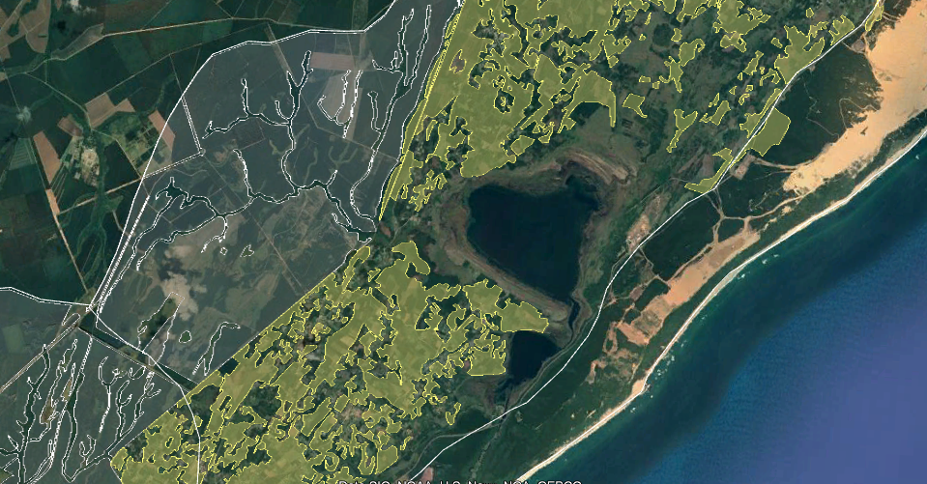
Eg. Around Lake Nhlabane

Slide 22
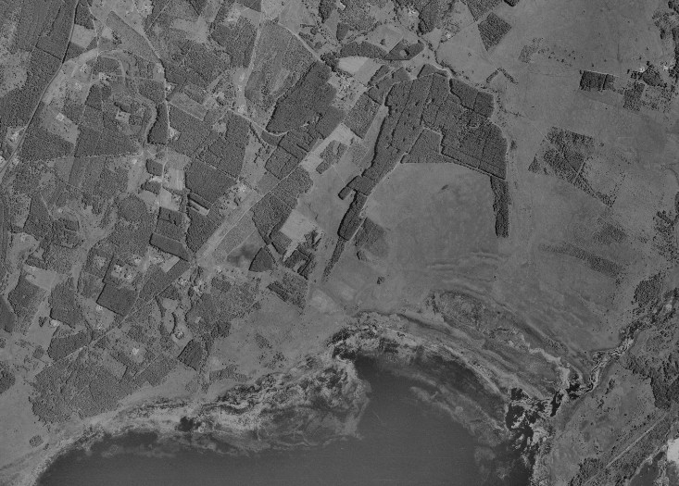
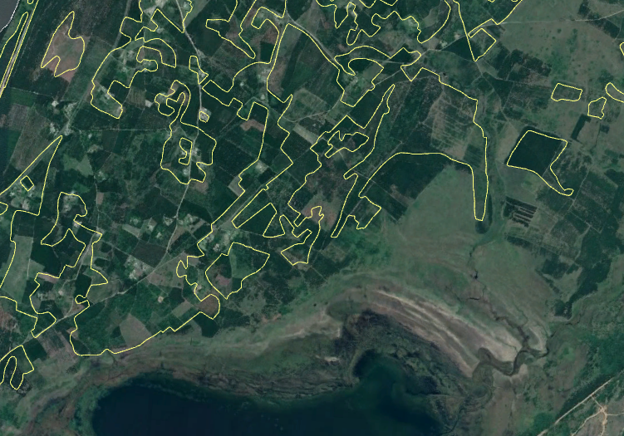
2001 aerial photo vs 2019 Google Earth

Slide 23
Recommendation
Plot the locations of the 712ha lawful individual growers in GIS and pull into Google Earth
Determine the extent of informal timber falling outside these boundaries
Target removal of informal growers that are not registered, especially in a buffer zone around the Coastal Lakes.

Slide 24
7.3 OTHER
Action | Responsibility | Comments
Desalination Initiate a pre-feasibility Study to evaluate the desalination of seawater | TBD | To be reported on under item 9.3
Implement seawater quality monitoring for 2 years to provide baseline data for plant process design | TBD
Reuse of treated effluent Initiate a feasibility Study to evaluate aspects Indirect effluent reuse from Lake Mzingazi Potential uptake of treated effluent by bulk industrial users clos to Arboretum macerator | CoU LM

Slide 25
7.3 OTHER (….Cont)
Action | Responsibility | Timing
Reinstate the billing of irrigators for actual water use | DWS: NWRI | High
Determine sustainable yields of coastal lakes | DWS: NWRP | Very High
RBM: artificial recharge of Lake Nhlabane from Mfolozi River | RBM | Sokhulu by 2019
Establish additional reliable flow monitoring between Goedertrouw and Mhlathuze weir | DWS: Hydrology | High

Slide 26
IMPLEMENTATION AND MAINTENANCE OF THE WATER RECONCILIATION STRATEGY FOR RICHARDS BAY AND SURROUNDING TOWNS
Strategy Steering Committee Meeting
(StraSC) 3
Item 8: Overview of Study Activities

Slide 27
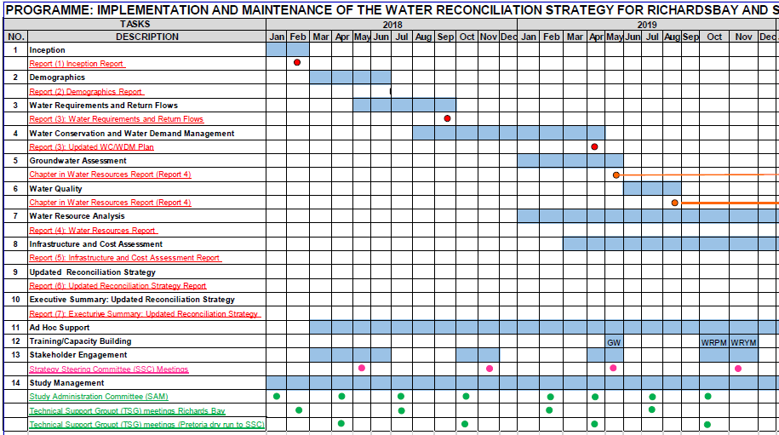
STUDY PROGRAMME

Slide 28
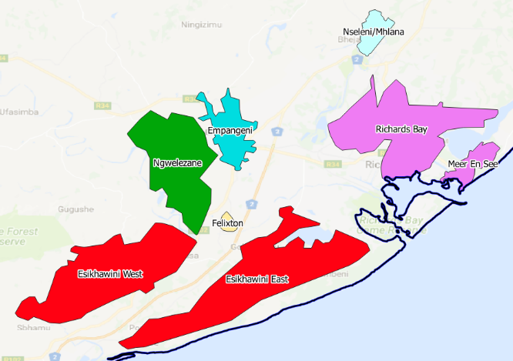
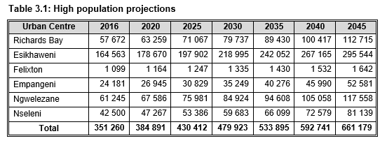
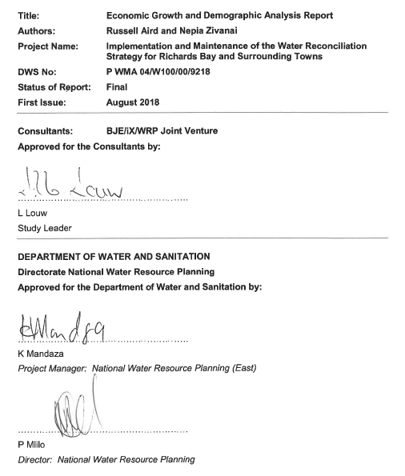
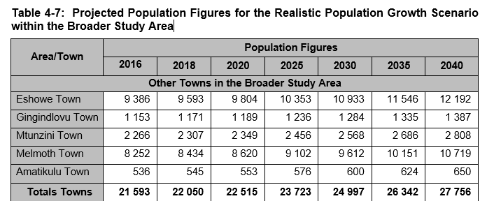
TASK 2: Demographics & Socio-Economics

Slide 29
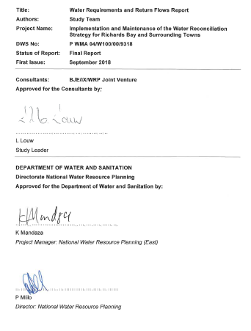
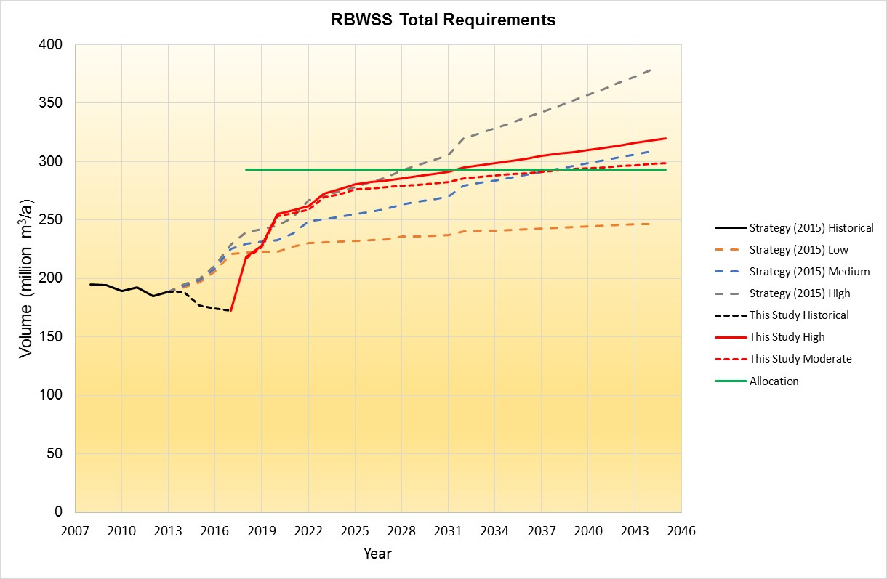
TASK 3: Water Requirements & Return Flows

Slide 30
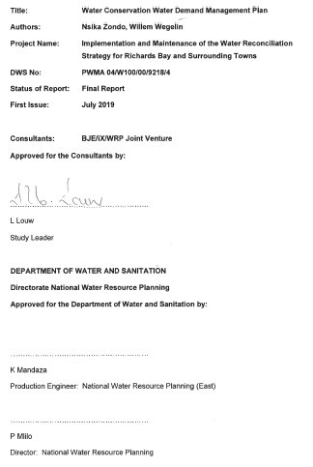
TASK 4: WC/WDM

Slide 31
IMPLEMENTATION AND MAINTENANCE OF THE WATER RECONCILIATION STRATEGY FOR RICHARDS BAY AND SURROUNDING TOWNS
Strategy Steering Committee Meeting
(StraSC) 3
Item 9: Current Progress

Slide 32
IMPLEMENTATION AND MAINTENANCE OF THE WATER RECONCILIATION STRATEGY FOR RICHARDS BAY AND SURROUNDING TOWNS
Strategy Steering Committee Meeting
(StraSC) 3
Item 9.1: Groundwater-Lake Assessment

Slide 33
Background
The WAA (MWAAS) Study identified a need to incorporate groundwater features from the groundwater lake module into WRYM
WAA of Mhlathuze did incorporate groundwater inflow to lakes at a coarse level with limited calibration based on existing reports and developed a lake module for Pitman Model
Recon Strategy (2015) stated “groundwater contribution to lake yields has not been taken into account in the WAA modelling, hence likely that the modelled lake yields are too low or incorrect. Groundwater contributions to the lakes could not be quantified with an acceptable level of confidence” reference from MORFP not MWAAS

Slide 34
New Tasks – This study
Calibrate lake hydrology based on:
Revised afforestation in lake catchments
Separation of lake catchments into Quinary
Recalibration of Pitman model in lake catchments
Utilisation of DWS data on lake levels and discharges in calibration
Derivation of lake surface water inflow, groundwater inflow and outflow time series 1920-2003

Slide 35
Justification
3 of the coastal lakes (Mzingazi, Nhlabane and Cubhu) have significant groundwater inflows and outflows and cannot be simulated using Pitman model without taking groundwater into account
A method is required to calculate groundwater contributions in a manner compatible with Pitman Model (90+ year monthly time series)
Changing rainfall-runoff and recharge relationship due to afforestation
Calibration of lake level and discharge where data exists
Output compatible with WRYM/WRPM
Model must incorporate changing weir elevation and area-storage relationships

Slide 36
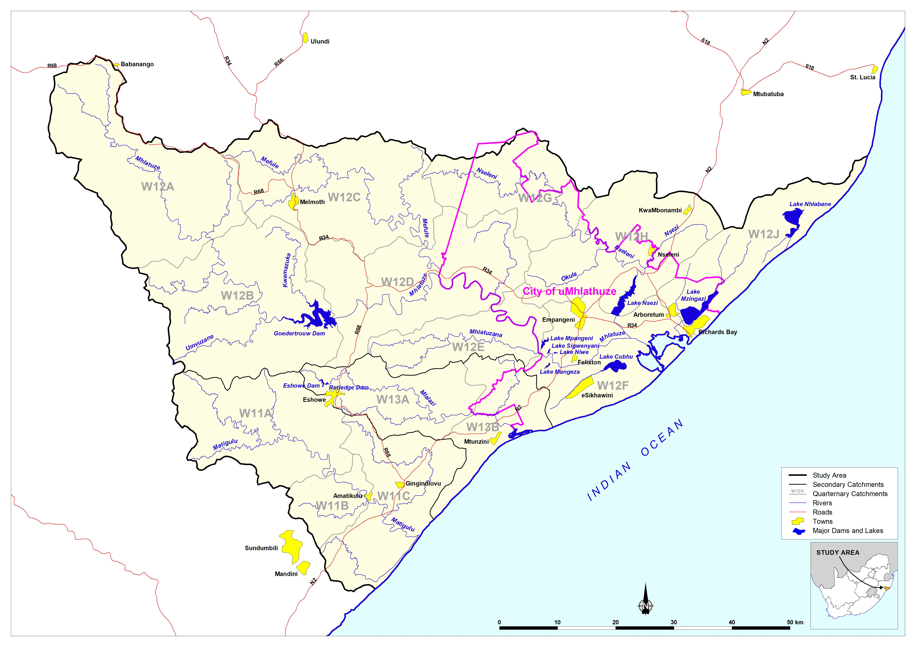
Coastal Lakes

Slide 37
Coastal Lakes - Cubhu, Mzingazi and Nhlabane
Fed by rainfall interception, surface runoff from riparian zones, stream baseflow, direct groundwater seepage
Runoff is largest component of water balance, hence accurate SW-GW modelling is critical
Throughflow characteristics, with groundwater entering and discharging from the lakes
Seepage greatest near shoreline, decreasing exponentially with distance underneath the lake.

Slide 38
Approach
Lake catchments subdivided by groundwater basin (area contributing groundwater to the lake)
Pitman Model applied to generate surface water runoff to lakes (with growth of afforestation)
SW-GW interaction module in Pitman model (Sami module) applied to quinary feeding the lake to generate an aquifer storage time series with change in recharge dynamics due to afforestation
Aquifer storage, abstraction and surface water runoff input into lake module
Model calibrated against lake level and discharge data
Model naturalised to generate a lake surface water inflow, groundwater inflow and outflow time series

Slide 39
Structure of Lake Module
Rain f(rain, area)
Evap f(Pan data, factors, area)
Abstraction
Runoff (volume)
Runoff f(level, inflows, level pool routing)
Lake Module
Area =f(Vol)
Level = f(Vol)
Seepage f(K,gradient, storage, capacity, aquifer thickness, lake width, sediment factor) – discretised into zones
Outflow f(gradient, storage, transmissivity, capacity, width)

Slide 40
Lake Module
Area and level fluctuate as function of volume
Uses surface Inflows from Pitman model
Runoff routed using level pool routing as a function of level
GW inflow fluctuates with GW storage and is function of lake width/aquifer thickness ratio
Based on parameters already available

Slide 41
Lake Mzingazi Level

Slide 42
Lake Mzingazi Discharge simulated vs Outlet weir

Slide 43
Lake Mzingazi July Inflows
Dry Season GW contribution
Increasing GW contribution
Implication for water quality

Slide 44
Water Balance Post 1995
Inflows (Mm³/a) |  |  | Outflows (Mm³/a)
Rainfall |  | 14.79 | Evaporation |  | 13.64
Surface Inflow |  | 28.52 | Abstraction |  | 13.35
GW Inflow |  | 14.78 | Surface water outflow |  | 28.31
Lake Storage |  | 2.21 | Groundwater water outflow |  | 0.58
Surface inflow is 2/3 of contribution (includes baseflow)
GW Inflow 1/3 but most important in dry periods

Slide 45
Lake Nhlabane water level

Slide 46
Lake Nhablane – Runoff and GW Inflows
Declining Runoff
GW sustains the lake during dry periods
Constant at 23.5 Mm3/a (12 200 m3/d)

Slide 47
Lake Nhlablane – Water Balance 1975-2005
Inflow |  |  | Outflow
Rainfall Mm³/a |  | 13.11 | Evaporation Mm³/a |  | 12.29
Surface Runoff Mm³/a |  | 23.48 | Abstraction Mm³/a |  | 10.94
Gwater inflow Mm³/a |  | 4.45 | Runoff Mm³/a |  | 16.26
Lake Storage Mm³/a |  | 1.05 | Gwater outflow Mm³/a |  | 0.50
TOTAL |  | 41.04 | TOTAL |  | 39.99
1920-1975
Inflow |  |  | Outflow
Rainfall Mm³/a |  | 9.21 | Evaporation Mm³/a |  | 8.47
Surface Runoff Mm³/a |  | 23.72 | Abstraction Mm³/a |  | 0.00
GWater Inflow Mm³/a |  | 4.50 | Runoff Mm³/a |  | 28.38
Storage Mm³/a |  | 0.07 | Gwater outflow Mm³/a |  | 0.51
TOTAL |  | 37.43 | TOTAL |  | 37.36

Slide 48
Lake Cubhu

Slide 49
Way Forward
Naturalise by removing afforestation and keeping outlet weirs at present level to generate T/S of surface and groundwater inflow and outflow
Hydrology has slight variations to WAA hydrology for the lake catchments. Does it affect yield?
Recommendations for incorporation of revised lake hydrology into Yield Model

Slide 50
QUESTIONS FOR CLARIFICATION

Slide 51
IMPLEMENTATION AND MAINTENANCE OF THE WATER RECONCILIATION STRATEGY FOR RICHARDS BAY AND SURROUNDING TOWNS
Strategy Steering Committee Meeting
(StraSC) 3
Item 9.2: Water Resources Assessment

Slide 52
TASK 7: Water Resources
  Hydrology, system yields, water resource model configuration, groundwater (subtask 5)
  Previous Water Resources Studies:
    Mhlathuze Operating Rules and Future Phasing (2001)
    Mhlathuze Water Availability Assessment (2009)
    Modelling Support for Licensing Scenarios (2012)
    Stand Alone Dams (Rutledge & Eshlazi) (2015)
    Goedertrouw AOA (2017 & 2019)
  Water Resources Summary, Recon Strategy (2015)

Slide 53
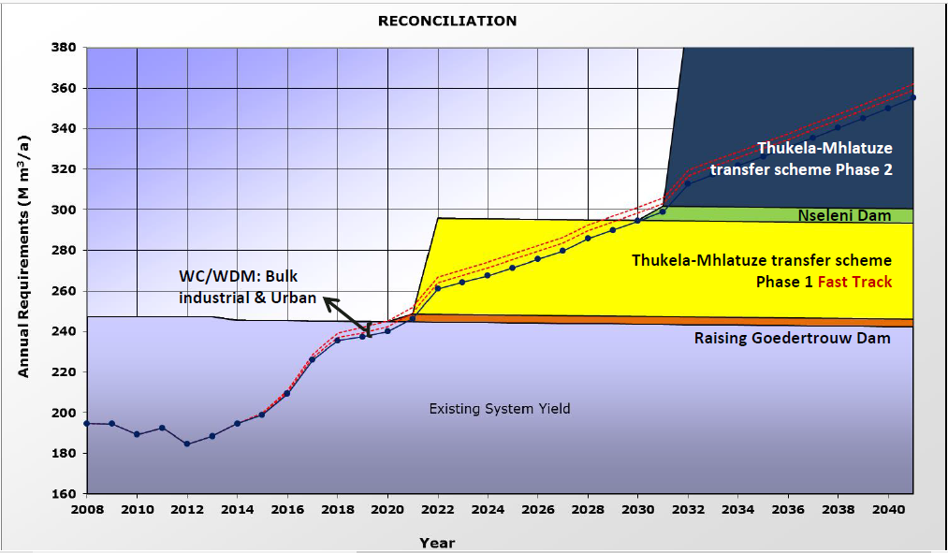
Recon (2015) Final Strategy Report
247.3 million m³/a
Demands to exceed existing yield: 2021
High growth projection system demand to reach 355 million in 2040

Slide 54
Components to configure water resources model
  Hydrology, (rainfall, streamflow) MWAAS 1920-2004
  Infrastructure
    Existing dams and transfers
    Future options
  Water requirement projections
    Individual users per sector
    Scenario options
  Environmental requirements
  Operating Rules

Slide 55
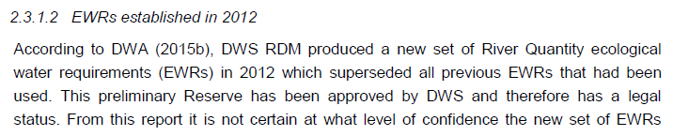
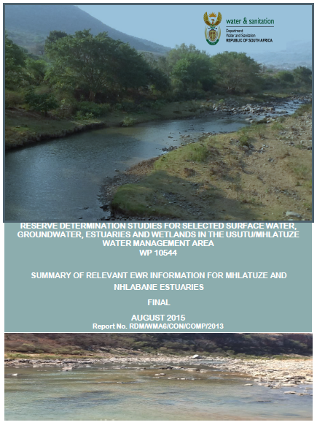
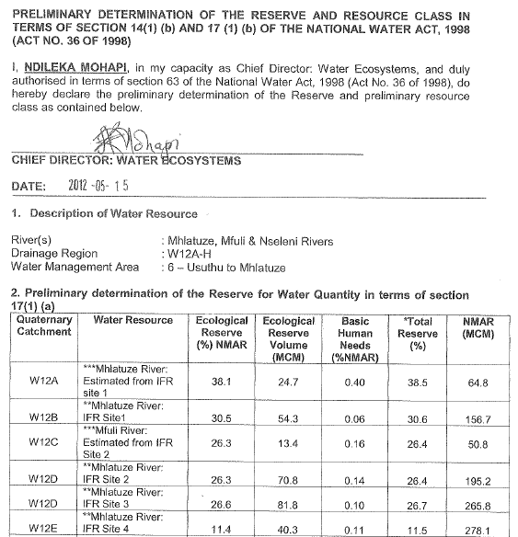
Environmental Requirements

Slide 56
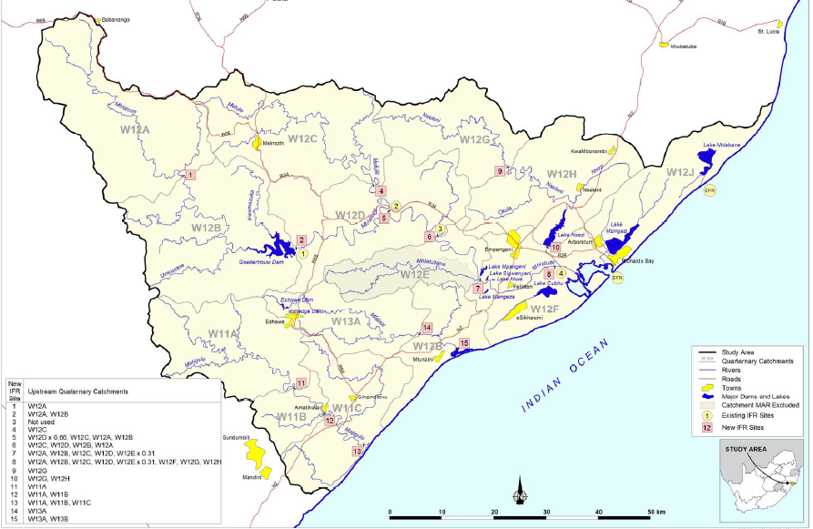
EWR Site Locations

Slide 57
Operating Rules
  Thukela transfer (pumping) only until Goedertrouw full (current 1.2 m³/s increased to 2.4 m³/s, less 10%)
  Lake minimum maintenance levels applicable
  Secondary supply from Mhlathuze weir to Esikhaweni WTW, to be used when Lake Cubhu drops below maintenance level
  Secondary supply from Nsezi WTW to Richards Bay, to be used when Lake Mzingazi drops below maintenance level and Mzingazi WTW shuts down
  RBM
    Smelter priority Lake Nhlabane, 2nd Lake Nsezi
    Ponds, priority Umfolozi, 2nd Lake Nhlabane, 3rd Lake Nsezi

Slide 58
Modelling Approach
  Multiple Stochastic flow projected sequences used, ie. results not just based on single historical sequence
  Impose growing demands on system, allow restrictions based on yield capability of resources
  System “deficit” occurs when the risk of user restrictions exceeds allowable risk as stipulated in priority classification table

Slide 59
User Sector Priority Classification Table
  NB: has direct impact on yield available from system
Risk of Non Supply | Assurance (failure recurrence) | Irrigation | Domestic | Industry
Very Low | 1:200 |  | 30% | 70%
Low | 1:100 |  | 30% | 20%
Medium | 1:50 | 50%
High | 1:20 |  | 30% | 10%
Very High | 1:4 | 50% | 10%
Risk of Non Supply | Assurance (failure recurrence) | Irrigation | Domestic | Industry
Very Low | 1:200 |  | 30% | 70%
Low | 1:100 | 20% | 30% | 20%
Medium | 1:50 | 40%
High | 1:20 |  | 30% | 10%
Very High | 1:4 | 40% | 10%
Total |  | 100% | 100% | 100%

Slide 60
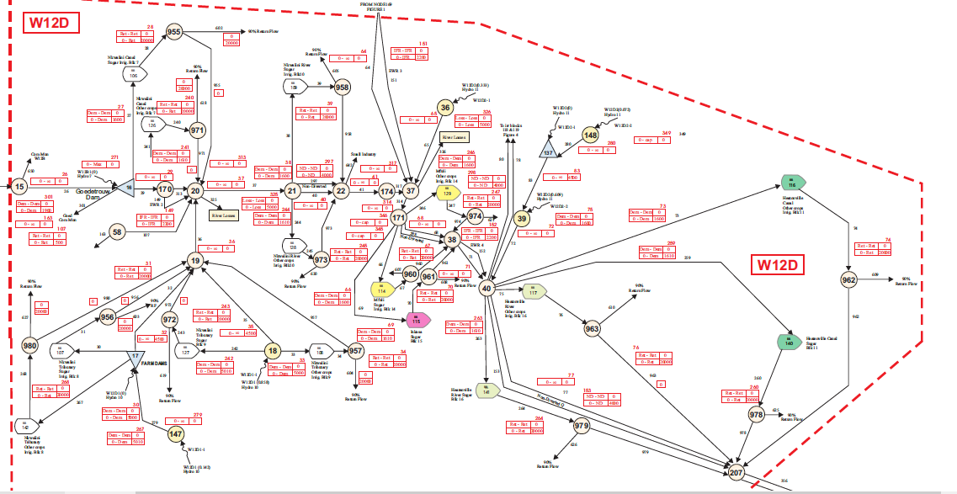
Eg. Of Network Diagram

Slide 61
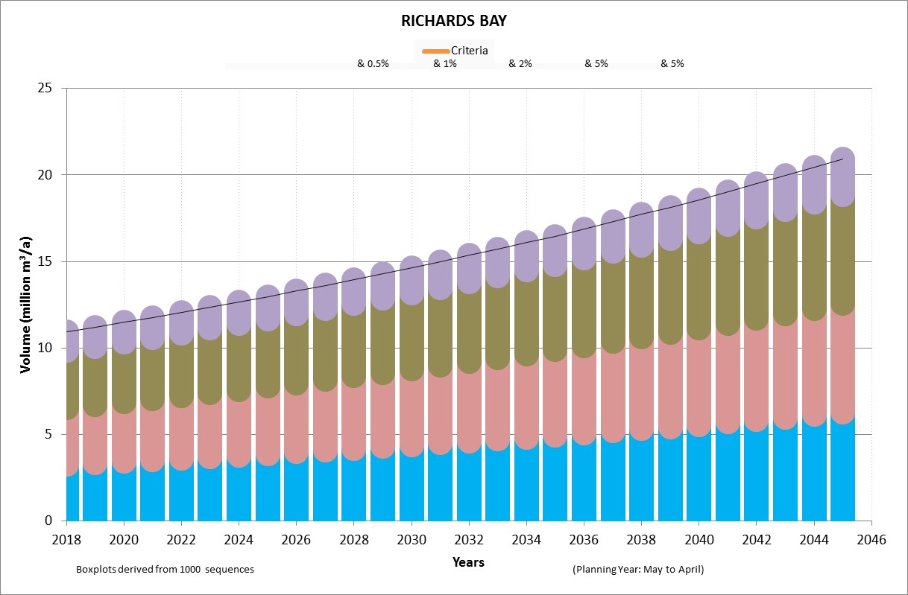
Typical Model results
(Lake Mzingazi)
10% demand: 1 in 4 year risk of failure
30% demand: 1 in 20 year risk of failure
30% demand: 1 in 100 year risk of failure
30% demand: 1 in 200 year risk of failure

Slide 62

(Lake Mzingazi)
1 in 4
1 in 200
1 in 20
1 in 4
1 in 100
1 in 20
1 in 100
1 in 200

Slide 63
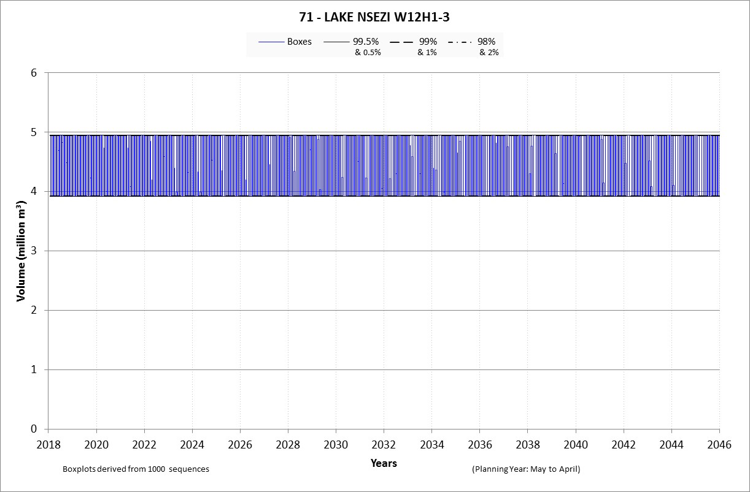
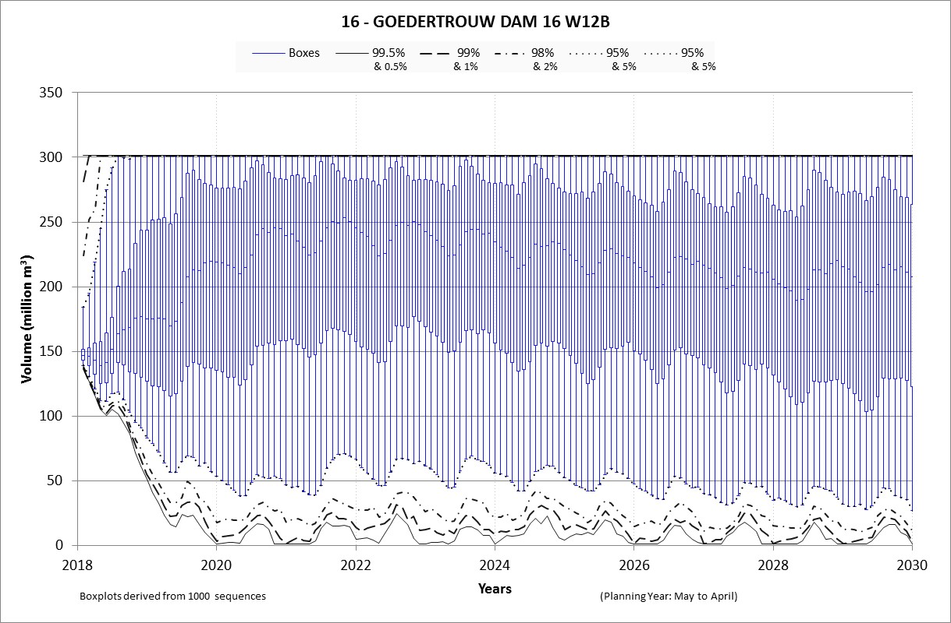
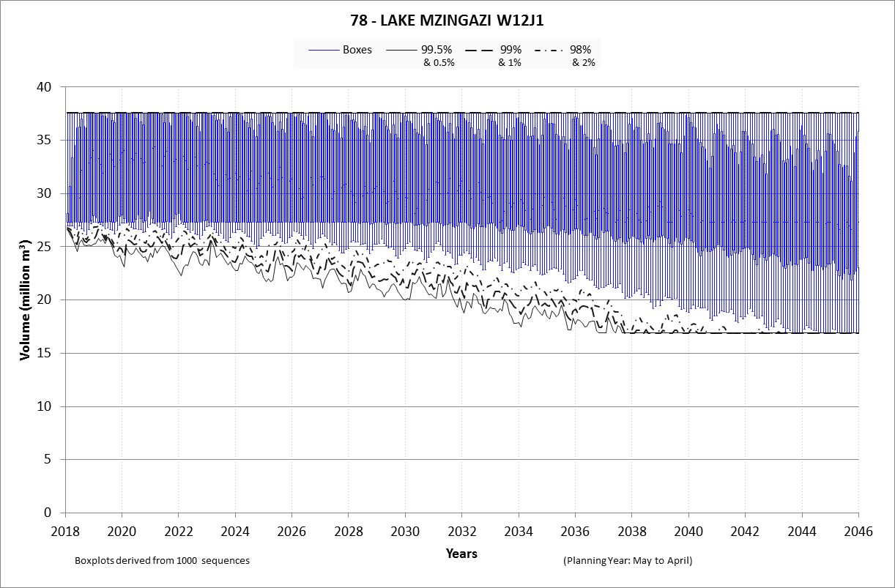
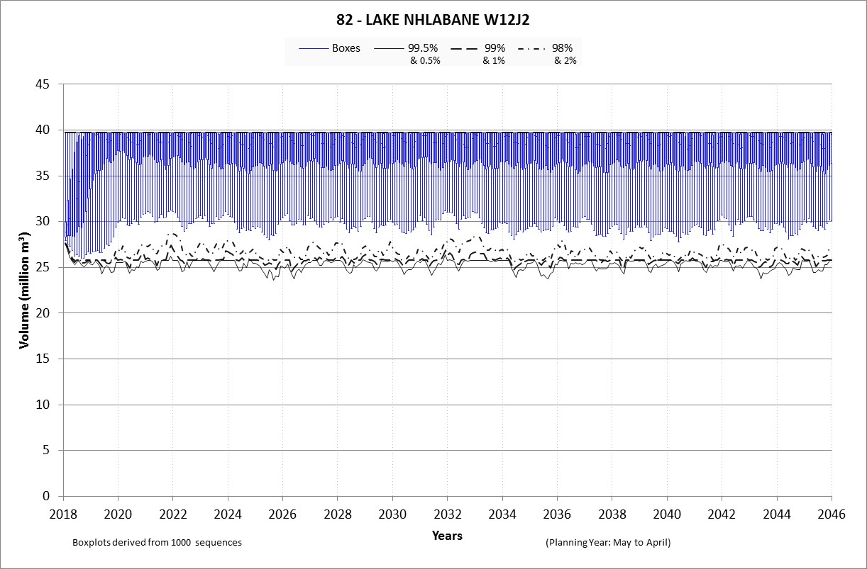
Model results

Slide 64
Simplified water balance
High demand projection additional users
High demand projection existing users
High demand projection existing users incl. WCWDM
Allocation
Irrigation
Volume (million m³/annum)
Industrial
Urban
Years

Slide 65
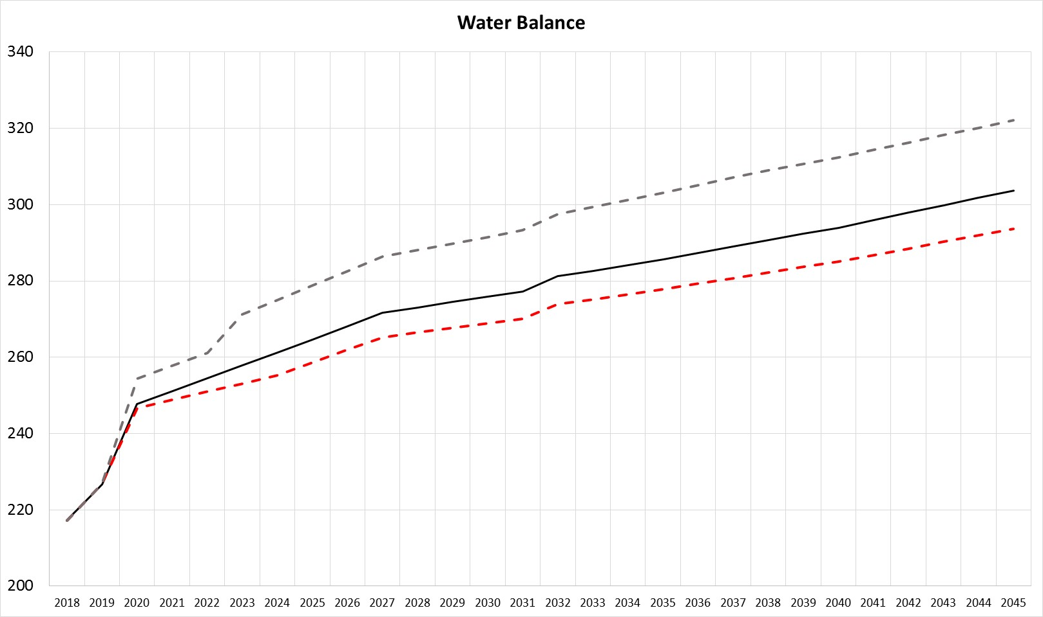
Adjusted scale
High demand projection additional users
High demand projection existing users
High demand projection existing users incl. WCWDM
Volume (million m³/annum)
Years

Slide 66
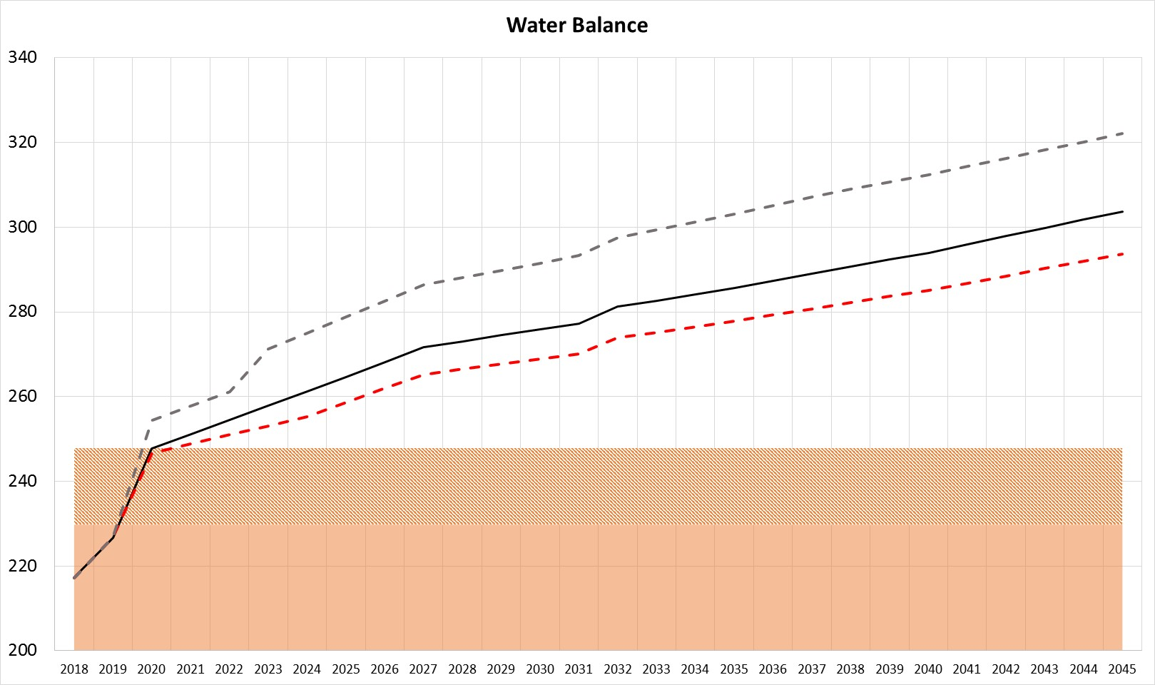
Simplified water balance
High demand projection additional users
High demand projection existing users
High demand projection existing users incl. WCWDM
Volume (million m³/annum)
Including efficient operation
Existing yield: including Thukela Phase 1
Years

Slide 67
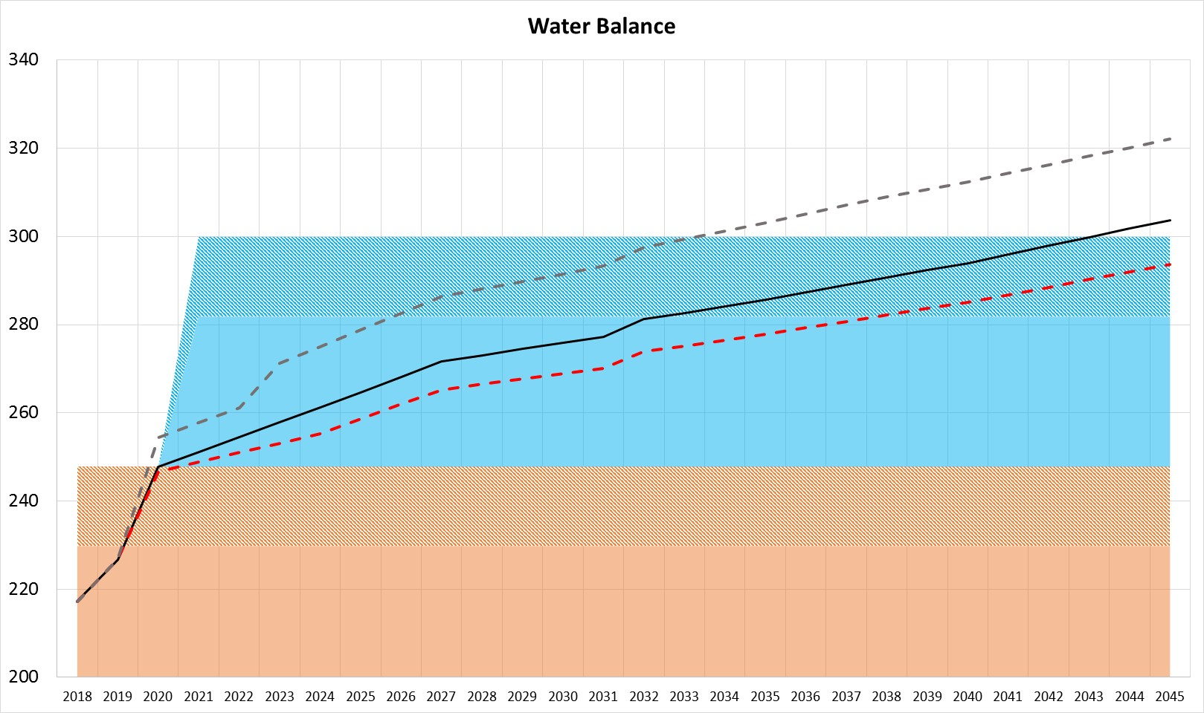
Simplified water balance
High demand projection additional users
High demand projection existing users
High demand projection existing users incl. WCWDM
Volume (million m³/annum)
Thukela Phase 2
Including efficient operation
Existing yield: including Thukela Phase 1
Years

Slide 68
Deficit summary
Demand projection | Existing incl Thukela ph 1 efficient operation | Thukela ph 2 & efficient operation
High existing users | 2020 | 2043
High additional users | 2020 | 2033
High existing with WCWDM | 2021 | >2045

Slide 69
Recon (2015)
vs
Current update
Thukela Phase 2
Existing yield: including Thukela Phase 1

Slide 70
Scenarios to be analysed & way forward
  Assess individual users’ supply profiles
  Additional augmentation/intervention options
  Climate change impacts
  Results from Lake assessment
  Surrounding town’s water balances

Slide 71
IMPLEMENTATION AND MAINTENANCE OF THE WATER RECONCILIATION STRATEGY FOR RICHARDS BAY AND SURROUNDING TOWNS
Strategy Steering Committee Meeting
(StraSC) 3
Item 9.3: Infrastructure & Cost Assessment

Slide 72
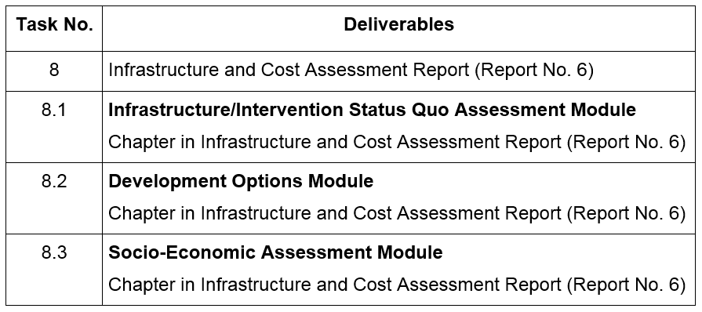
task 8: INFRASTRUCTURE AND COST ASSESSMENT
Task 8 relates to the infrastructure of the intervention options identified during the previous Reconciliation Strategy, including the related financial implications.
The Task has been divided into three subtasks with deliverables:

Slide 73
Deliverable 8.1: Infrastructure / Intervention Status Quo Assessment Module
Potential interventions were identified in the Previous Richards Bay Reconciliation Strategy, which could contribute to meeting the future water requirements of the Richards Bay WSS.
This module addresses the findings of the status quo assessment carried out for the intervention options identified in the Richards Bay and Surrounding Towns Study Area.

Slide 74
Interventions
An intervention can be any measure that could potentially make additional water available i.e. that improves the water balance of the Richards Bay WSS.
It can therefore be demand-side (lowering water requirements) or supply side (increasing the water supply) focused.

Slide 75
The following potential augmentation options have been selected during the previous study for further evaluation:
Raising Goedertrouw Dam
Dam on the Nseleni River
Bulk industrial and Urban water conservation and water demand management
Increased capacity of the Thukela-Mhlathuze Transfer Scheme (Middledrift Transfer Scheme)
Coastal pipeline from the lower Thukela River
Off-channel transfer scheme/s from the Mfolozi River
Desalination of seawater, and
Arboretum Effluent Reuse Scheme.

Slide 76
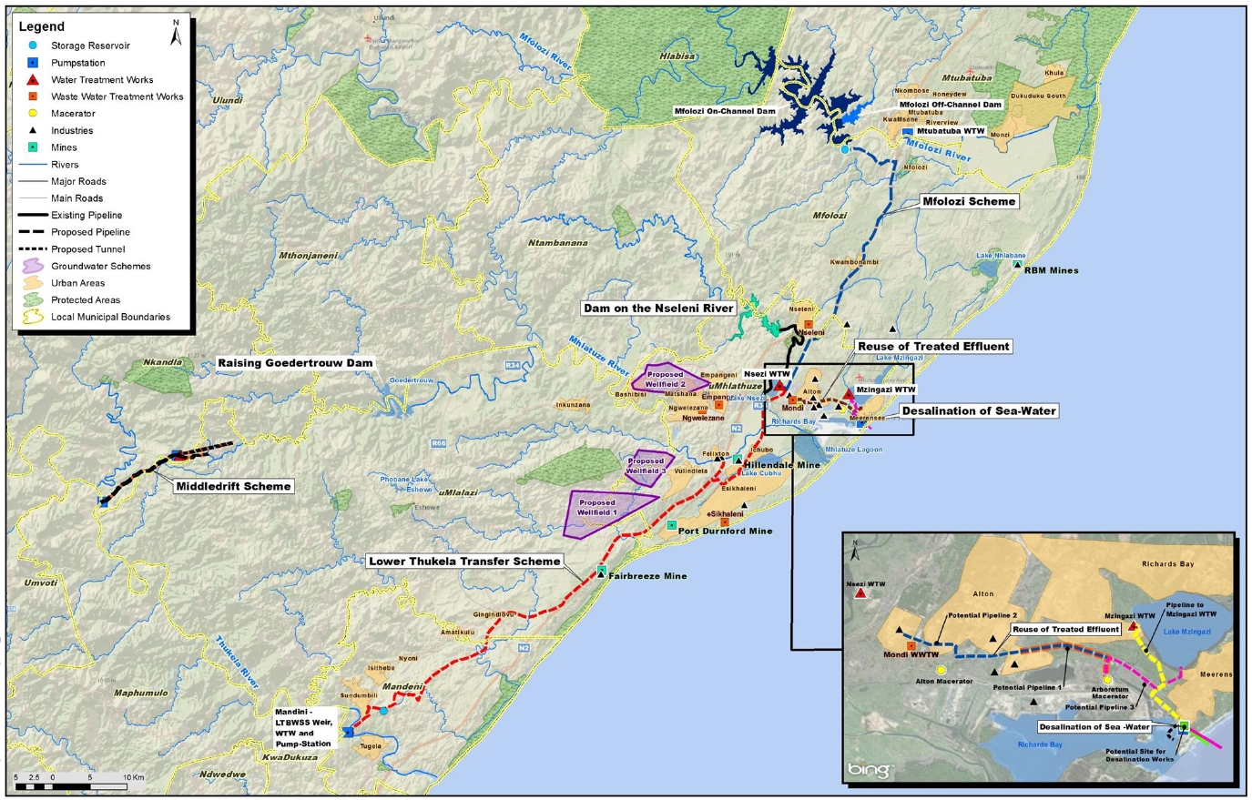
Mfolozi Off-Channel Dam
Mfolozi Scheme
Dam on Nseleni River
Reuse of Treated Effluent
Raising Goedertrouw Dam
Desalination of Seawater
Middledrift Transfer Scheme
Coastal Pipeline from Lower Thukela River
Locality Plan – All Schemes

Slide 77
Baseline Interventions
Four small attractive options have been identified that can provide smaller yields to increase the water availability of the region. These so-called baseline interventions, which are recommended for all water balance scenarios are:
Raising of Goedertrouw Dam:
Seems very promising as it can be implemented fairly quickly, apart from being very cost effective.
New Dam on the Lower Nseleni River
Beneficial from a cost perspective. It could further offer operational benefits, but could likely not be implemented quickly.
Bulk Industrial and Urban WC/WDM
Initiatives should continue and water efficiency should be improved.

Slide 78
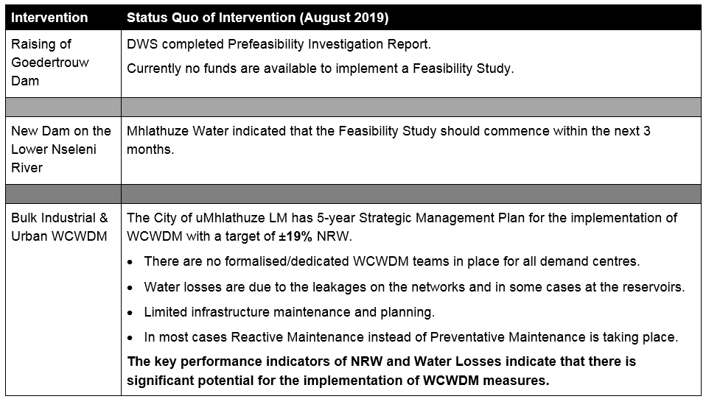
Status Quo: Baseline Interventions

Slide 79
Key Interventions
Three significant schemes (that would make large quantities of water available) have been identified to meet the future water requirements of the Richards Bay WSS.
Thukela-Mhlathuze Transfer Scheme (Middledrift Transfer Scheme)
Lower Thukela 55Mℓ/d Coastal Pipeline
A transfer scheme from an off-channel dam situated close to the Mfolozi River
Desalination of seawater
A medium-sized scheme that seems promising and should be compared with the three schemes is the Arboretum Effluent Reuse Scheme.

Slide 80
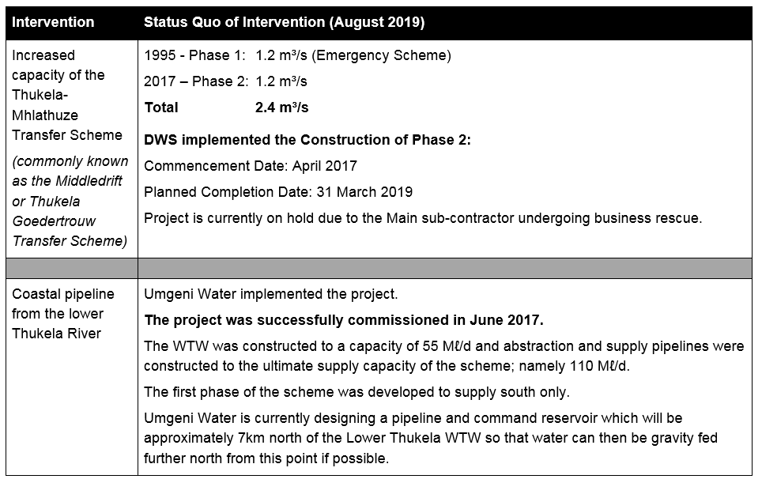
Status Quo: Key Interventions (1 of 2)

Slide 81
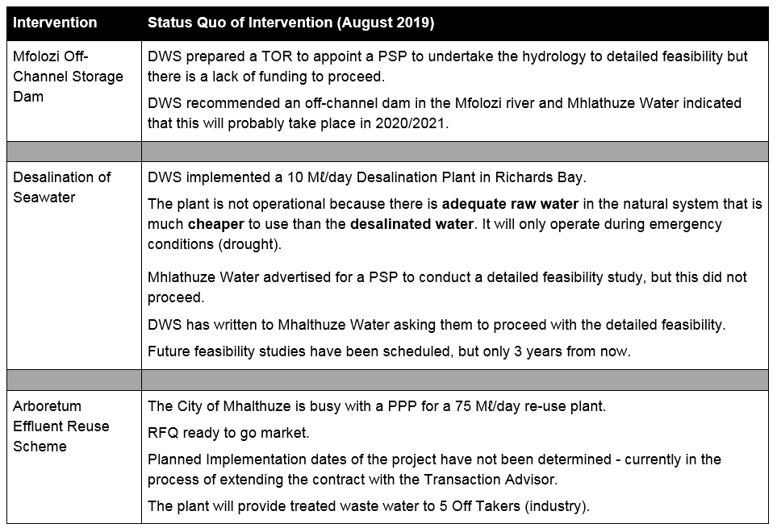
Status Quo: Key Interventions (2 of 2)

Slide 82
Questions?

Slide 83
IMPLEMENTATION AND MAINTENANCE OF THE WATER RECONCILIATION STRATEGY FOR RICHARDS BAY AND SURROUNDING TOWNS
Technical Support Group Meeting
(TSG) 6
Item 10: Discussion and Comments

